Slide 1
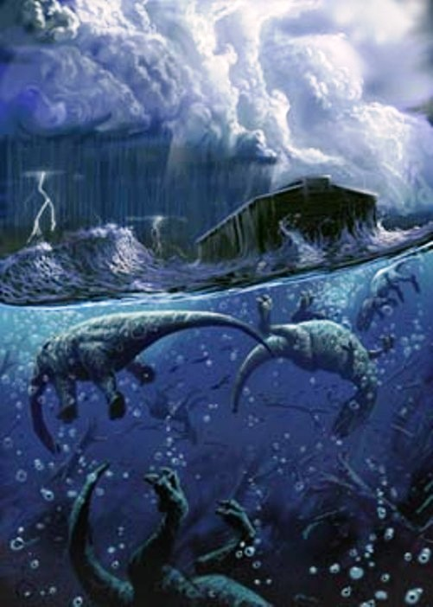
The Genesis Flood
Fact or Fiction?

Slide 2
The Biblical Account
The Cause:
The Wickedness of man
Then the LORD saw that the wickedness of man was great in the earth, and that every intent of the thoughts of his heart was only evil continually. And the LORD was sorry that He had made man on the earth, and He was grieved in His heart.
Genesis 6:5-6

Slide 3
The Biblical Account
The Purpose:
Destruction of all flesh.
So the LORD said, “I will destroy man whom I have created from the face of the earth, both man and beast, creeping thing and birds of the air, for I am sorry that I have made them.”
Genesis 6:7

Slide 4
The Biblical Account
The Purpose:
Destruction of all flesh.
And God said to Noah, “The end of all flesh has come before Me, for the earth is filled with violence through them; and behold, I will destroy them with the earth.
Genesis 6:13

Slide 5
The Biblical Account
The Purpose:
Destruction of all flesh.
For after seven more days I will cause it to rain on the earth forty days and forty nights, and I will destroy from the face of the earth all living things that I have made.”
Genesis 7:4

Slide 6
The Biblical Account
Global.
The Extent:
Now the flood was on the earth forty days. The waters increased and lifted up the ark, and it rose high above the earth. ¹⁸ The waters prevailed and greatly increased on the earth, and the ark moved about on the surface of the waters. ¹⁹ And the waters prevailed exceedingly on the earth, and all the high hills under the whole heaven were covered. ²⁰ The waters prevailed fifteen cubits upward, and the mountains were covered.
Genesis 7:17-20

Slide 7
The Biblical Account
The Extent:
Global.
Now the flood was on the earth forty days. The waters increased and lifted up the ark, and it rose high above the earth. ¹⁸ The waters prevailed and greatly increased on the earth, and the ark moved about on the surface of the waters. ¹⁹ And the waters prevailed exceedingly on the earth, and all the high hills under the whole heaven were covered. ²⁰ The waters prevailed fifteen cubits upward, and the mountains were covered.
Genesis 7:17-20

Slide 8
The Biblical Account
The Result:
All land animals and man died.
And all flesh died that moved on the earth: birds and cattle and beasts and every creeping thing that creeps on the earth, and every man. ²² All in whose nostrils was the breath of the spirit of life, all that was on the dry land, died. ²³ So He destroyed all living things which were on the face of the ground: both man and cattle, creeping thing and bird of the air. They were destroyed from the earth. Only Noah and those who were with him in the ark remained alive.
Genesis 7:21-23

Slide 9
The Genesis Flood
Objections:
Only a local flood.
Not enough water.
Ark not big enough.
Where did water go?

Slide 10
The Genesis Flood
Was the flood of Noah merely a local flood like we see today?
If it were merely a local flood there would have been no need for an ark.
A local flood would not have accomplished God’s purpose, which was the destruction of every land creature.
The Biblical account says the the the mountains (all of them) were covered to a depth of 15 cubits (23 feet).

Slide 11
The Genesis Flood
Mount St. Helens
Perhaps the most remarkable catastrophic events to have occurred at Mt. St. Helens was the rapid erosion that was accomplished by mudflows, landslides, and waves of water. On March 19, 1982 a small eruption melted the snow that had accumulated in the crater over the winter, and a resulting hot mud flow carved a system of canyons up to 140 feet deep and 17 miles long in a single day. The deepest of the canyons has affectionately been called the little Grand Canyon of the Toutle River, and is 1/40th the size of its namesake. The small creek that now flows through the bottom would appear to have carved this canyon over a great length of time, but this unique event has demonstrated that rapid catastrophic processes were instead responsible. The Grand Canyon in Arizona has also been claimed for some time to have been carved gradually by the Colorado River, but it is now becoming clear this American icon is as well the result of catastrophic erosion.

Slide 12
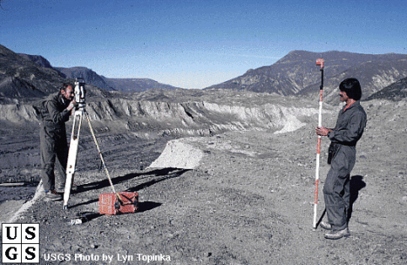
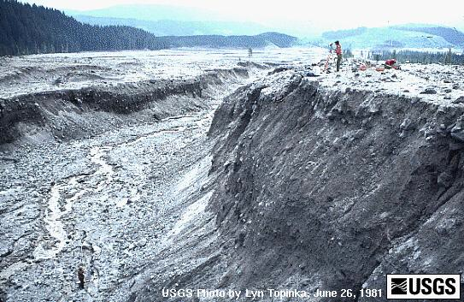
The Genesis Flood
Mount St. Helens

Slide 13
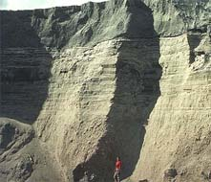
The Genesis Flood
Mount St. Helens
Stratified layers up to 400 feet thick formed as a result of landslides, pyroclastic flow, mudflows, etc., during the Mt. St. Helens eruption. Fine laminae from only a millimeter thick to more than a meter high formed in just a few seconds each. A deposit more than 25 feet in thickness, and containing upwards of 100 thin layers accumulated in just one day on June 12, 1980. Naturalists have long claimed that stratified layer such as those found in the geological column have accumulated over vast periods of time, and these laminates represent long season variations or annual changes. However, the Mt. St. Helens deposits have demonstrated that catastrophic processes are able to create these geological formations in a short period of time.

Slide 14
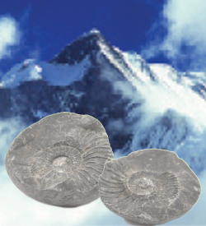
The Genesis Flood
Marine fossils on the tops of mountains!
Fossil ammonites (coiled marine cephalopods) like this one are found in limestone beds high in the Himalayas of Nepal. How did marine fossils get thousands of feet above sea level?

Slide 15
The Genesis Flood
There is not enough water in our atmosphere to flood the whole earth.
The water didn’t come from only the atmosphere.
In the six hundredth year of Noah’s life, in the second month, the seventeenth day of the month, on that day all the fountains of the great deep were broken up, and the windows of heaven were opened.
Genesis 7:11

Slide 16
The Genesis Flood
There is not enough water in our atmosphere to flood the whole earth.
The water didn’t come from only the atmosphere.
There was probably much more water in the atmosphere than there is today.
Then God said, “Let there be a firmament in the midst of the waters, and let it divide the waters from the waters.”
Genesis 1:6

Slide 17
The Genesis Flood
Some claim the ark could not have been big enough to fit all of the land animals.
When one considers the size of the ark, this argument falls apart.
Not only that but, Noah would have only had to take two of each “kind” not “species.”
And of every living thing of all flesh you shall bring two of every sort into the ark, to keep them alive with you; they shall be male and female. ²⁰ Of the birds after their kind, of animals after their kind, and of every creeping thing of the earth after its kind, two of every kind will come to you to keep them alive.
Genesis 6:19-20

Slide 18
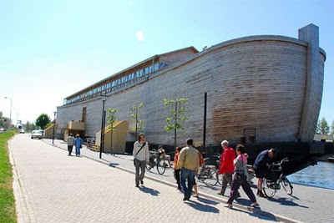
The Genesis Flood
Was the ark big enough?
Dimensions: 450’ x 75’ x 45.
Floor space = 100,000 sq. ft.
Volume = 1,500,000 cubic ft.
Volume = 569 boxcars.
Boxcar can hold 240 sheep.
It has been estimated that Noah would have need to have room for about 35,000 individual animals.
Considering a sheep to be an average size animal... 35,000 sheep could fit into 150 boxcars. 1/3 the size of the ark.
Plenty of room is left for Noah, his family, and all the supplies.

Slide 19
The Genesis Flood
Where did the water go?
He set the earth on its foundations, so that it should never be moved. ⁶ You covered it with the deep as with a garment; the waters stood above the mountains. ⁷ At your rebuke they fled; at the sound of your thunder they took to flight. ⁸ The mountains rose, the valleys sank down to the place that you appointed for them. ⁹ You set a boundary that they may not pass, so that they might not again cover the earth.
Psalm 104:5-9
(ESV)

Slide 20
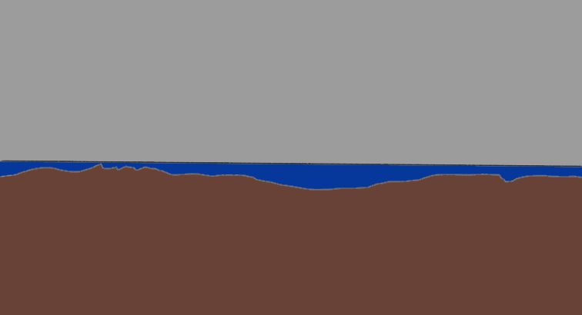
Before the flood:
Relatively low mountains compared to today.
Relatively shallow oceans.

Slide 21
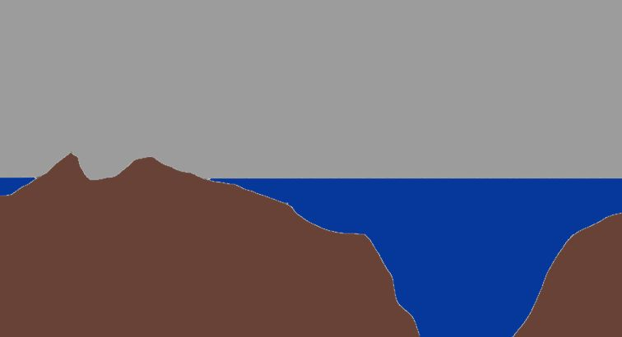
After the flood:
Much higher mountains.
Much deeper oceans.

Slide 22
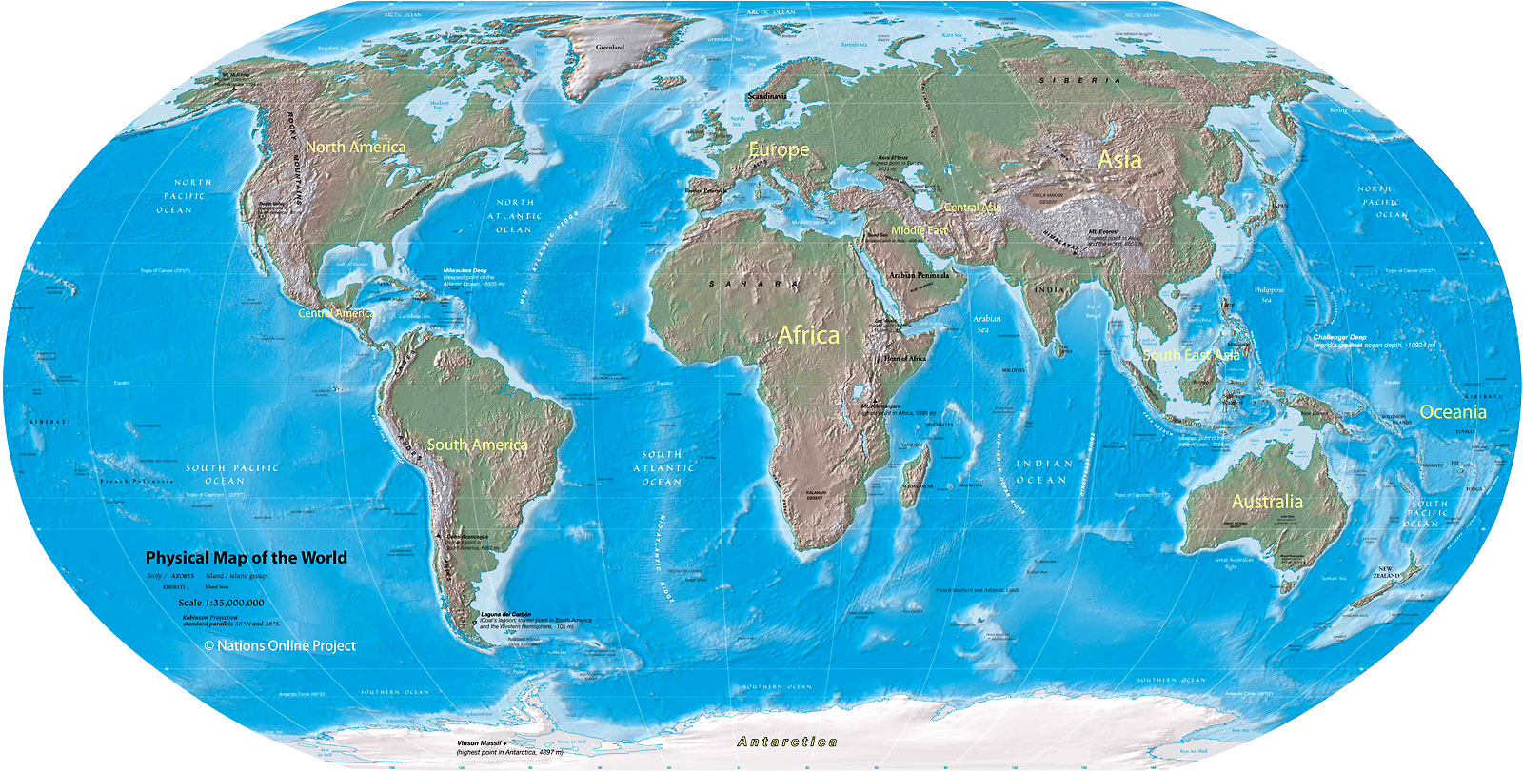

Slide 23
The Genesis Flood
Where did the water go?
Average height of land above sea level: 2755 ft.
Average ocean depth: 12,677 ft.
If all the land were scraped into the oceans, the oceans would still be 1.7 miles deep!
⁹ You set a boundary that they may not pass, so that they might not again cover the earth.

Slide 24
The Genesis Flood
Beloved, I now write to you this second epistle (in both of which I stir up your pure minds by way of reminder), 2 that you may be mindful of the words which were spoken before by the holy prophets, and of the commandment of us, the apostles of the Lord and Savior, 3 knowing this first: that scoffers will come in the last days, walking according to their own lusts, 4 and saying, “Where is the promise of His coming? For since the fathers fell asleep, all things continue as they were from the beginning of creation.”
2 Peter 3:1-9

Slide 25
The Genesis Flood
5 For this they willfully forget: that by the word of God the heavens were of old, and the earth standing out of water and in the water, 6 by which the world that then existed perished, being flooded with water. 7 But the heavens and the earth which are now preserved by the same word, are reserved for fire until the day of judgment and perdition of ungodly men.8 But, beloved, do not forget this one thing, that with the Lord one day is as a thousand years, and a thousand years as one day.
2 Peter 3:1-9

Slide 26
The Genesis Flood
9 The Lord is not slack concerning His promise, as some count slackness, but is longsuffering toward us, not willing that any should perish but that all should come to repentance.
2 Peter 3:1-9

Slide 27
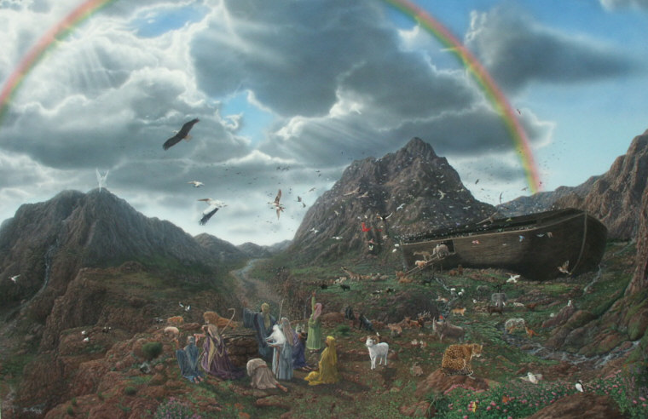

Slide 28
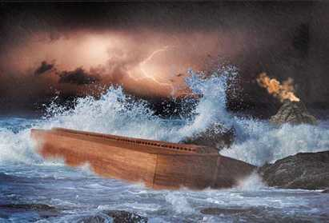

Slide 29
